Slide 1
TechRental.asia TechRental.vn SeenPay.com
Founder: Huy Le
Business Models: Lumoid.com, LensRentals.com, BorrowLenses.com, DigitalRev.com, Alipay

Slide 2
What is TechRental.vn?
TechRental.vn aims to be the top smart rental and trading service in Vietnam and South East Asia in the future. We make it incredibly easy and affordable to try and trade amazing technology products. We cater to your technology desires and needs.

Slide 3
Mission
We evolving the way people rent and trade simply and smartly.
We help people make decision easier by trying the item first, comparing and making final decision.

Slide 4
The solution for Everyone
…who could not afford the item.
…who has a dilemma in making purchasing decision of different products.
…who need it the item immediately.
…who would like to show-off.
…who love technology products.

Slide 5
What do TechRental.vn offer?
Smart & Simple Rental Service (Rent)
Trading regardless item’s location (Trade)
Technology Products Review

Slide 6
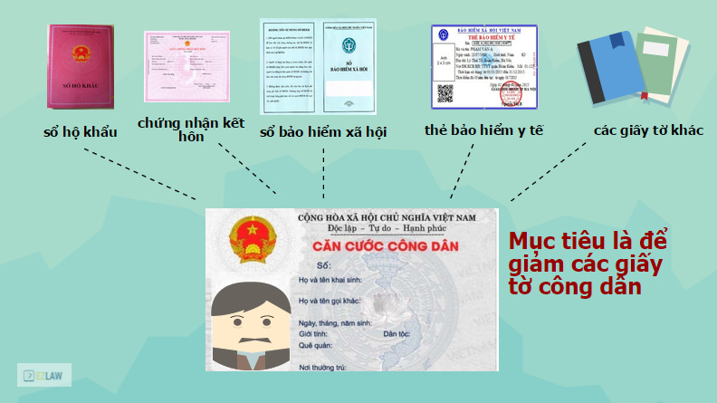
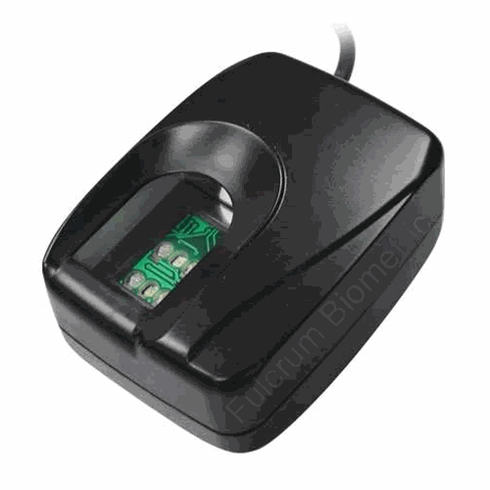
Simple Rental Service
What you need to provide us?
Citizen ID (Can Cuoc Cong Dan)
Basic Information (Address, Full name, etc)
Bank Account (Debit/Credit Card Number)
Check the item’s availability online
Create an account with us and make reservation
Pick up the item at the time you request or the item will be delivered to the place your requested place (Hochiminh City, Hanoi, Danang)
When picking up the item, we need your fingerprint

Slide 7
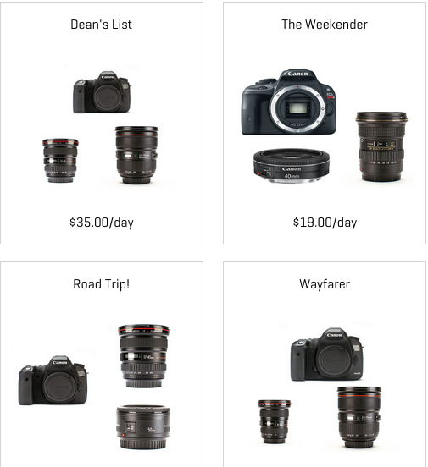
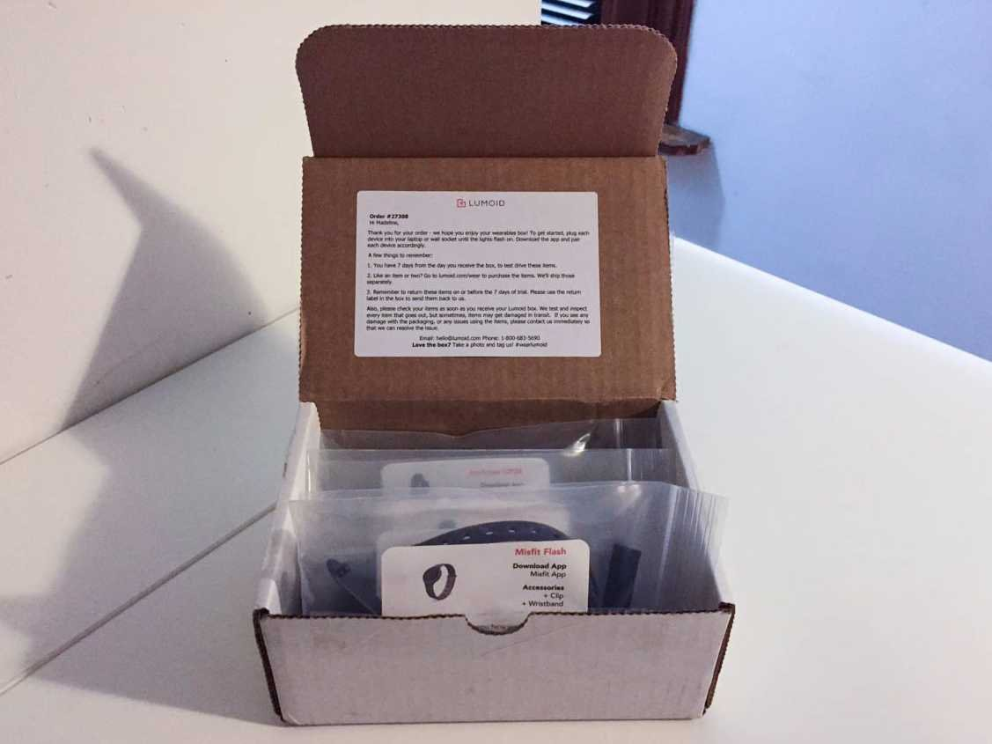
Simple Rental Service
One Item Rental
Box Rental
Combo Rental
Combo
Box

Slide 8
Technology Products Review
Reviewing technology products full of humor and plenty detail of specs.
Community driven review for each product we have on our site.

Slide 9
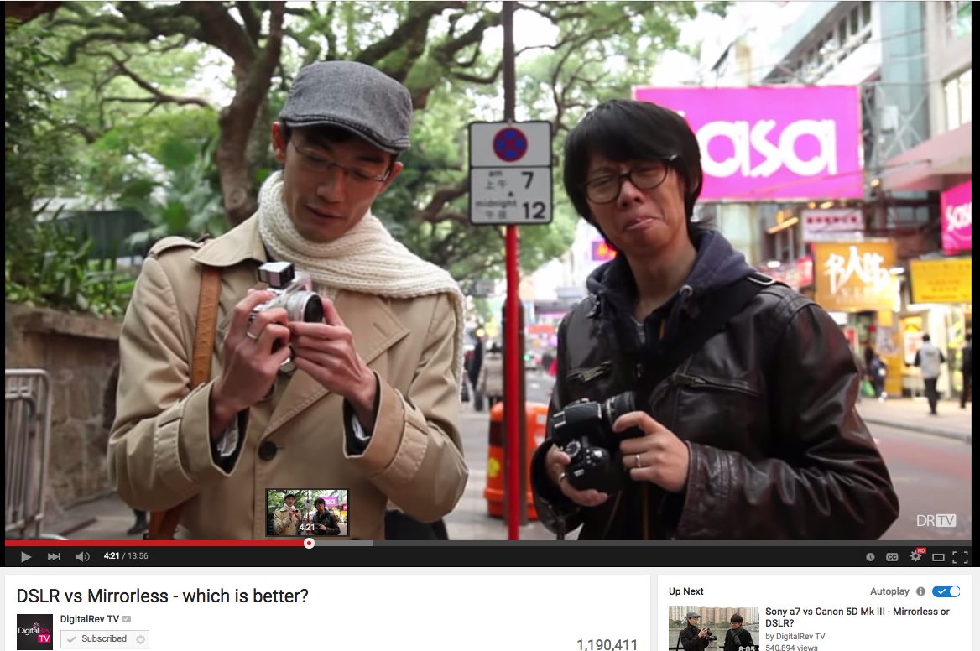
Review from TechRental’s experts
(our experts will use the product, and you watch it)

Slide 10
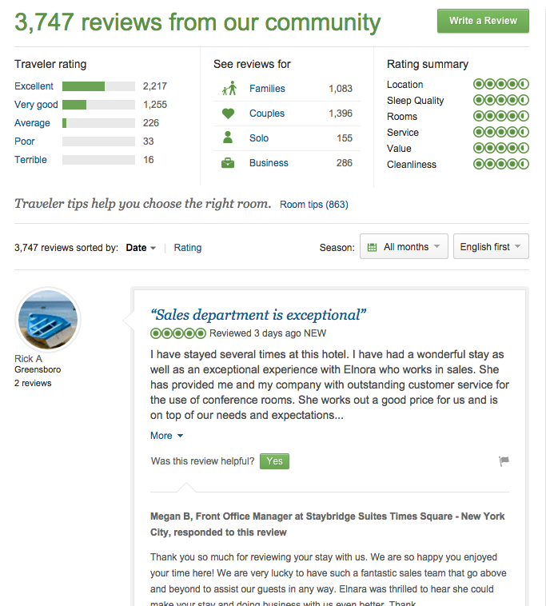
Community Driven Review

Slide 11
Trade
Trade from TechRental’s second-hand items (get used item’s salvage value)
Trade between consumers by using SeenPay

Slide 12
Why SeenPay?
Why not Paypal?
The Asia market is different, Asian people prefer touch and test the used item first then release the money to the seller.
SeenPay is the solution, you seen it, we release the money

Slide 13
SeenPay
SeenPay
Buyer
$
Seller
$
$
Item from seller to buyer

Slide 14
SeenPay
How to use?
SeenPay is the Third Party, SeenPay will stay between buyer and seller.
Register the trade
Buyer send money to SeenPay (SeenPay will hold the money but not release to Seller until Buyer receive the item and agree to pay)
If Buyer agree to pay, SeenPay will release the money to Seller
If Buyer want to return, SeenPay will return the money to Buyer and the product to Seller
Transaction and delivery fee is charged:
If transaction failed: Default = Buyer pay (Can be arrange by Buyer and Seller)
If transaction success: Default = Seller pay (Can be arrange by Buyer and Seller)

Slide 15





Business Models

Slide 16


Target Market
Vietnam Market (Launch 2017)
ASEAN Countries (Launch 2020)

Slide 17
Market Demand Classification
Professional
Entry Level
Amateur
Photographer or people who interested in Cameras & Accessories
Tech Lovers

Slide 18
Marketing
Inbound Marketing
Marketing through famous blogger, youtuber and etc.
Customers bring customers
Free Tech Trial at our office
Free Tech Consulting and Maintenance

Slide 19
Current Asia Market
Low Labor Income
Low Income
Low Purchasing Power
Tech Products is Pricey
RENT

